Slide 1

Exploring Real-Time Horizons with Microsoft Fabric
Kristyna Ferris
Don’t forget to grab some stickers!

Slide 2

DP-700 Offer
Fast-track your career in data and AI
Become a Microsoft Certified Fabric Data Engineer Associate – take Exam DP-700 for free!
Visit the Fabric Community Lounge to learn more about this limited-time offer.
aka.ms/fabcon/dp700

Slide 3

Learn more about Microsoft Fabric
Power your AI transformation with a complete data platform

Slide 4





Get Involved
in the Fabric
Community
aka.ms/FabricCommunity Connect with community members, ask questions, and learn more about Fabric
aka.ms/FabricUserGroups
Find a user group that matches your interests in your area or online
aka.ms/SuperUsers
Spread your Fabric knowledge, insights, and best practices with others
aka.ms/MVP Technology experts that share their knowledge and passion with the community

Slide 5

About Me ~ Kristyna Ferris
Microsoft MVP, Data Platform Lexington Data Tech Group co-organizer Co-author on DataOnWheels Co-founder of Data On Rails
Blog - https://dataonwheels.wordpress.com/ LinkedIn - https://www.linkedin.com/in/kristyna-ferris-dataonwheels/
Twitter - @data_dragoness

Slide 6

Prerequisites
Fabric capacity backed workspace (trial capacities work well for this)
Streaming data source
A working relationship with time — no time travel experience required
Notes:
Don’t be afraid to try this yourself!
An F2 capacity is very cheap, especially if you pause it when you’re not using it.

Slide 7
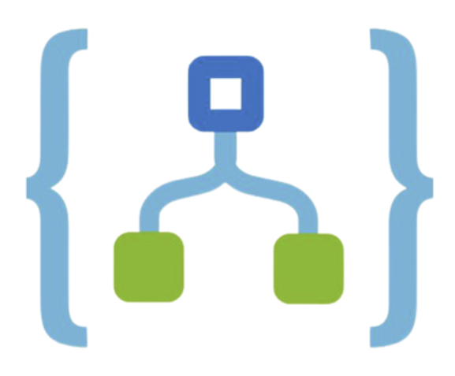





Real-Time Demo Architecture
ISS REST APIs
Logic Apps
Event Streams
Event House
Power BI

Slide 8
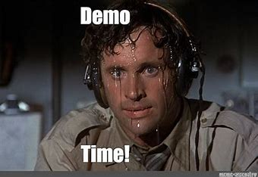

Slide 9
Create Event House
This step is easier than you think! All you need to do is come up with a fun name.
We will not be creating any tables at this stage as those will be added from the Event Streams.
Notes:
Don’t worry about making tables, we will do that during the event stream creation.

Slide 10
Create Event Streams
We have two sources of data (astronauts and ISS location).
So, we need two Event Streams to capture that data.
The source will be a custom app. Hold off on making the destination until after we make the Logic Apps.
Notes:
Do not connect to the event house yet. All we are doing is grabbing the connection string key. You will also need to grab the event stream id.

Slide 11
Create Logic Apps
Navigate to Azure Portal
Create 2 Logic Apps
Don’t forget to add the body of the HTTP response to the Send Event action
Must be a consumption plan
Notes:
This is our only non-Fabric piece of the puzzle.
We will be using free, anonymous REST API to connect to ISS data.
Make sure the logic app is a Consumption app, NOT standard.
You will need to use a custom name for the event stream even after using the connection. The drop down doesn’t work for Fabric.
Use the second connection string.
http://api.open-notify.org/iss-now.json
http://api.open-notify.org/astros.json

Slide 12
Finish Event Streams
Go back to the event streams and connect them to the KQL database.
This will create the tables we will use in Power BI.
Notes:
Test that the data is flowing through then create the tables in the event house.
Don’t forget to activate the connection (not in the editing experience).

Slide 13

Surveying the Data
KQL is not SQL!
The basic syntax of a tabular query is:
TABLE
| operator statement 1
| operator statement 2
Notes:
KQL quick reference: KQL quick reference - Azure Data Explorer & Real-Time Analytics | Microsoft Learn
KQL tutorial: Tutorial: Learn common Kusto Query Language operators - Azure Data Explorer & Real-Time Analytics | Microsoft Learn
ago() - Azure Data Explorer & Real-Time Analytics | Microsoft Learn

Slide 14
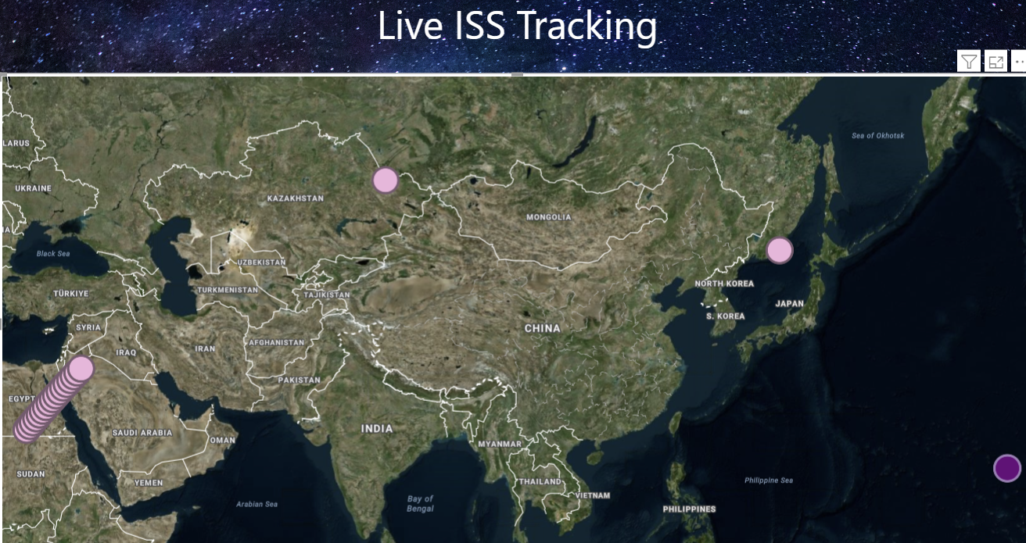
Create Power BI Report
Let’s pull in our latest timestamps to see the latest positions of the ISS.
By enabling the page refresh, we can see it move in near real time!
Notes:
Page refresh in power bi is in the capacity settings
How to configure workloads in Power BI Premium - Power BI | Microsoft Learn

Slide 15
Real-Time Demo Architecture
ISS REST APIs
Logic Apps
Event Streams
Event House
Power BI
Notes:
Recap

Slide 16

Questions?

Slide 17
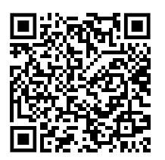
Don’t forget to connect, thanks for listening!
https://dataonwheels.wordpress.com/
kristyna@dataonwheels.com
@data_dragoness
GitHub

